Slide 1
MIS 637
Data Analytics and Machine Learning
Data Quality & Preprocessing
Cleaning, Transforming, and Exploring
M. Daneshmand
MD-MIS 637-Fall 2020

Slide 2
Why Do We Preprocess Data?
Data Understanding, Data Preparation
Raw data often incomplete, noisy
May contain:
  Obsolete fields
  Missing values
  Outliers
  Data in a form not suitable for data analytics
  Erroneous values
MD-MIS 637-Fall 2020

Slide 3
Why Do We Preprocess Data? (cont’d)
For data analytics purposes, database values must undergo data cleaning and data transformation
Data often from legacy databases where values:
  Not looked at in years
  Expired
  No longer relevant
  Missing
Minimize GIGO (Garbage In Garbage Out)
  IF garbage input minimized → THEN garbage in results minimized
Data preparation is 60% of effort for Data Analytics and Machine Learning process (Pyle)
MD-MIS 637-Fall 2020

Slide 4
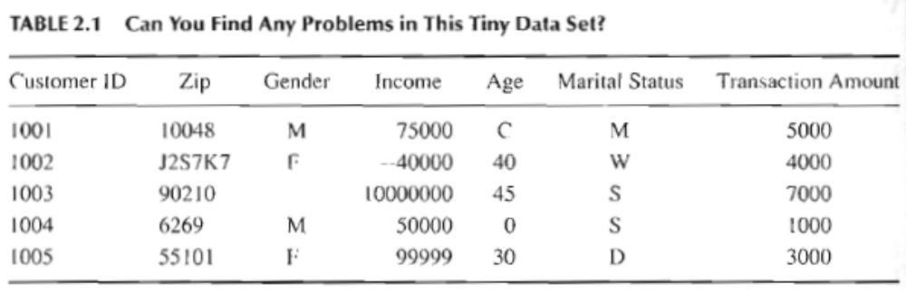
Data Cleaning
MD-MIS 637-Fall 2020

Slide 5
Data Cleaning
Data errors in Table 2.1 examined:
Five-numeral U.S. Zip Code?
  Not all countries use same zip code format, 90210 (U.S.) vs. J2S7K7 (Canada)
  Should expect unusual values in some fields
  For example, global commerce
Four Digit Zip Code?
  Leading zero truncated, 6269 vs. 06269 (New England states)
  Database field numeric and chopped-off leading zero
MD-MIS 637-Fall 2020

Slide 6
Data Cleaning (cont’d)
Income Field Contains $10,000,000?
  Assumed to measure gross annual income
  Possibly valid
  Still considered outlier (extreme data value)
  Some statistical and data mining methods affected by outliers
Income Field Contains -$40,000?
  Income less than $0?
  Value beyond bounds for expected income, therefore an error
  Caused by data entry error?
  Discuss anomaly with database administrator
MD-MIS 637-Fall 2020

Slide 7
Data Cleaning (cont’d)
Income Field Contains $99,999?
  Other values appear rounded to nearest $5,000
  Value may be completely valid
  Value represents database code used to denote missing value?
  Confirm values in expected unit of measure, such as U.S. dollars
  Which unit of measure for income?
  Customer with zip code J2S7K7 in Canadian dollars?
  Discuss anomaly with database administrator
MD-MIS 637-Fall 2020

Slide 8
Data Cleaning (cont’d)
Age Field Contains “C”?
  Other records have numeric values for field
  Record categorized into group labeled “C”
  Value must be resolved
  Data analytics software expects numeric values for field
Age Field Contains 0?
  Zero-value used to indicate missing/unknown value?
  Customer refused to provide their age?
MD-MIS 637-Fall 2020

Slide 9
Data Cleaning (cont’d)
Age Field?
  Date-type fields may become obsolete
  Use date of birth, then derive Age
Marital Status Field Contains “S”?
  What does this symbol mean?
  Does “S” imply single or separated?
  Discuss anomaly with database administrator
MD-MIS 637-Fall 2020

Slide 10
Handling Missing Data
Missing values pose problems to data analysis methods
More common in databases containing large number of fields
Absence of information rarely beneficial to task of analysis
In contrast, having more data almost always better
Careful analysis required to handle issue
MD-MIS 637-Fall 2020

Slide 11
Handling Missing Data (cont’d)
Examine cars dataset containing records for 261 automobiles manufactured in 1970s and 1980s
Delete Records Containing Missing Values?
  Not necessarily best approach
  Pattern of missing values may be systematic
  Deleting records creates biased subset
  Valuable information in other fields lost
Three Alternate Methods Available
  Insightful Miner (http://www.insightful.com) specifies method to replace values
MD-MIS 637-Fall 2020

Slide 12
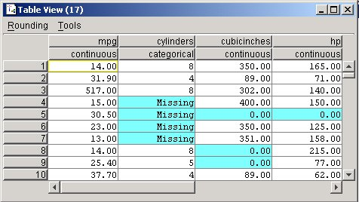
Handling Missing Data (cont’d)
(1) Replace Missing Values with User-defined Constant
  Missing numeric values replaced with 0.0
  Missing categorical values replaced with “Missing”
MD-MIS 637-Fall 2020

Slide 13
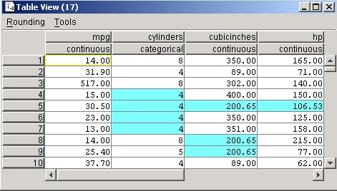
Handling Missing Data (cont’d)
(2) Replace Missing Values with Mode or Mean
  Mode of categorical field cylinders = 4
  Missing values replaced with this value
  Mean for non-missing values in numeric field cubicinches = 200.65
  Missing values replaced with 200.65
MD-MIS 637-Fall 2020

Slide 14
Handling Missing Data (cont’d)
  Substituting mode or mean for missing values sometimes works well
  Mean not always best choice for “typical” value
  Resulting confidence levels for statistical inference become overoptimistic (Larose)
  Domain experts should be consulted regarding approach to replace missing values
  Benefits and drawbacks resulting from the replacement of missing values must be carefully evaluated
MD-MIS 637-Fall 2020

Slide 15
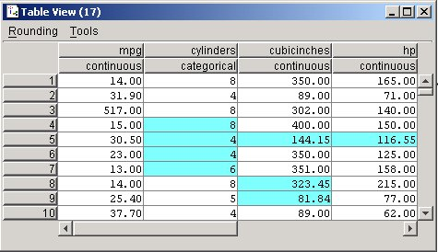
Handling Missing Data (cont’d)
(3) Replace Missing Values with Random Values
  Values randomly taken from underlying distribution
  Value for cylinders, cubicinches, and hp randomly drawn proportionately from each field’s distribution
  Method superior compared to mean substitution
  Measures of location and spread remain closer to original
MD-MIS 637-Fall 2020

Slide 16
Handling Missing Data (cont’d)
  No guarantee resulting records make sense
  Suppose randomly-generated values cylinders = 8 and cubicinches = 82
  A strange engine size?
  Alternate methods strive to replace values more precisely
  What is likely value, given record’s other attribute values?
  For example, American car has 300 cubic inches and 150 horsepower
  Japanese car has 100 cubic inches and 90 horsepower
  American car expected to have more cylinders
MD-MIS 637-Fall 2020

Slide 17
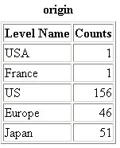
Identifying Misclassifications
  Verify values valid and consistent
  Frequency distribution shows five classes: USA, France, US, Europe, and Japan
  Count for USA = 1 and France = 1?
  Two records classified inconsistently with respect to origin of the manufacturer
  Maintain consistency by labeling USA → US, and France → Europe
MD-MIS 637-Fall 2020

Slide 18
Graphical Methods for Identifying Outliers
Outliers are values that lie near extreme limits of data range
Outliers may represent errors in data entry
Certain statistical methods very sensitive to outliers and may produce unstable results
Neural Networks and k-Means benefit from normalized data
MD-MIS 637-Fall 2020

Slide 19
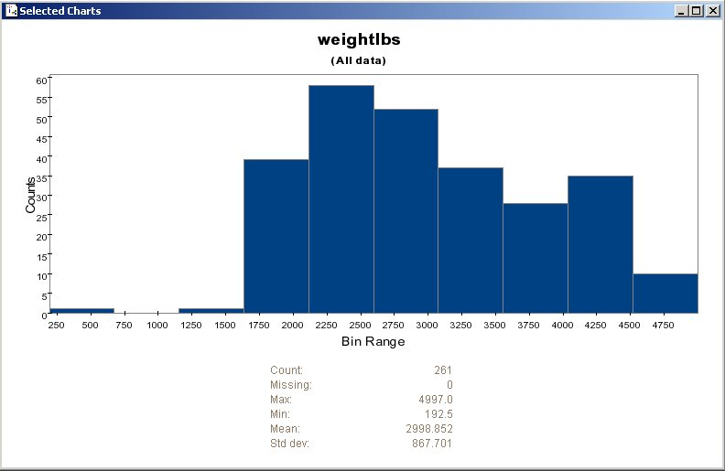
Graphical Methods for Identifying Outliers (cont’d)
  A histogram examines values of numeric fields
  This histogram shows vehicle weights for cars data set
  The extreme left-tail contains one outlier weighing several hundred pounds (192.5)
  Should we doubt validity of this value?
MD-MIS 637-Fall 2020

Slide 20
Graphical Methods for Identifying Outliers (cont’d)
  Analysis of weightlbs field shows remaining records contain whole-numbered (no decimal) values
  Perhaps value of 192.5 is an error
  Should it be 1925?
  Cannot know for sure and requires further investigation
  Discuss the meaning of the value with someone familiar with database content
MD-MIS 637-Fall 2020

Slide 21
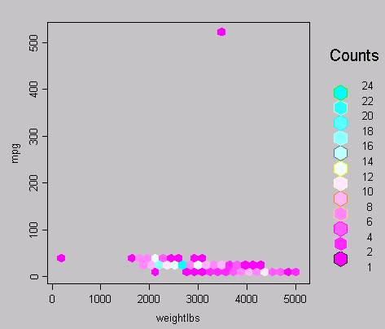
Graphical Methods for Identifying Outliers (cont’d)
  Two-dimensional scatter plots help determine outliers between variable pairs
  Scatter plot of mpg against weightlbs shows two possible outliers
  Most data points cluster together along x-axis
  However, one car weighs 192.5 pounds and other gets over 500 miles per gallon?
MD-MIS 637-Fall 2020

Slide 22
Data Transformation
Variables tend to have ranges different from each other
In baseball, two fields may have ranges:
  Batting average: [ 0.0, 0.400 ]
  Number of home runs: [ 0, 70 ]
Some data mining algorithms adversely affected by differences in variable ranges
Variables with greater ranges tend to have larger influence on data model’s results
Therefore, numeric field values should be normalized
Standardizes scale of effect each variable has on results
MD-MIS 637-Fall 2020

Slide 23
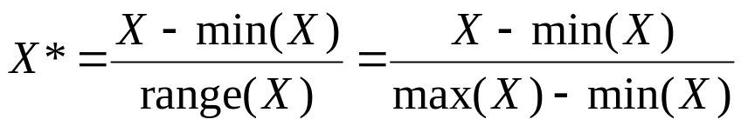
Data Transformation (cont’d)
Two prevalent normalization techniques available
(1) Min-Max Normalization
  Determines how much greater field value is than minimum value for field
  Scales this difference by field’s range
  From Figure 2.7, Min = 8 and Max = 25 for time-to-60 field
MD-MIS 637-Fall 2020

Slide 24
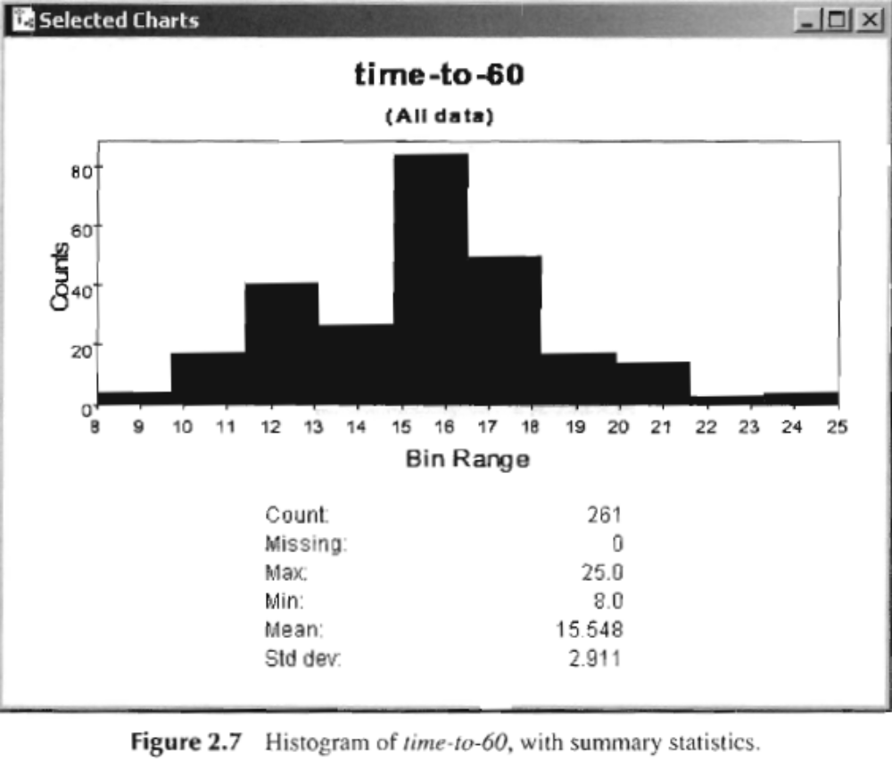
Data Transformation (cont’d)
MD-MIS 637-Fall 2020

Slide 25
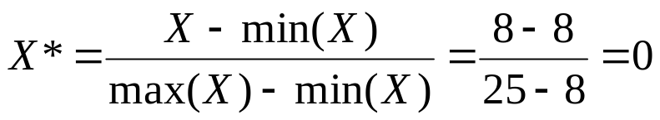
Data Transformation (cont’d)
  Find Min-max Normalization for three automobiles having time-to-60 values 8, 15.548, and 25
  Example: “drag-racing-ready” is fastest vehicle and takes 8 seconds to reach 60mph
  Min(time-to-60) = 8
  Using Min-max Normalization:
  Minimum field values for time-to-60 have Min-max Normalization
  value = 0
MD-MIS 637-Fall 2020

Slide 26
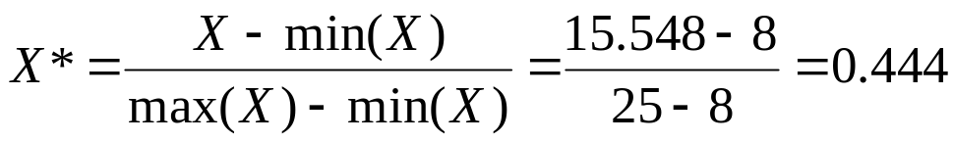
Data Transformation (cont’d)
  Example: Assume “average” vehicle takes 15.548 seconds to reach 60mph
  Avg(time-to-60) = 15.548
  Using Min-max Normalization:
  Field values near center of field’s distribution have Min-max Normalization values near 0.5
MD-MIS 637-Fall 2020

Slide 27
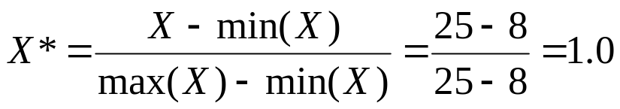
Data Transformation (cont’d)
  Example: The “I’ll get there when I’m ready” vehicle takes 25 seconds to reach 60mph
  Max(time-to-60) = 25
  Using Min-max Normalization:
  Maximum field values have Min-max Normalization
  value = 1
  Min-max Normalization values range [ 0, 1 ]
MD-MIS 637-Fall 2020

Slide 28
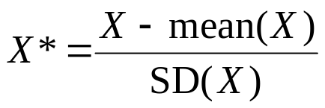
Data Transformation (cont’d)
(2) Z-score Standardization
  Widely used in statistical analysis
  Takes difference between field value and field value mean
  Scales this difference by field’s standard deviation
  From Figure 2.7, mean and standard deviation of time-to-60 equal 15.548 and 2.911, respectively
MD-MIS 637-Fall 2020

Slide 29
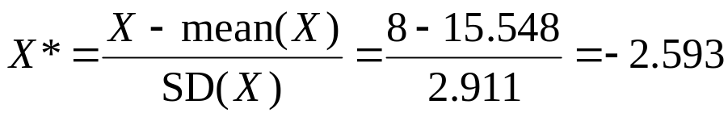
Data Transformation (cont’d)
  Example: Again, consider “drag-racing-ready” automobile which takes 8 seconds to reach 60mph
  Using Z-score Standardization:
  Data values that lie below the mean have negative Z-score Standardization values
MD-MIS 637-Fall 2020

Slide 30
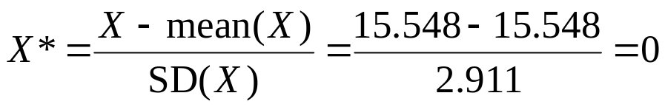
Data Transformation (cont’d)
  Example: Our “average” vehicle takes exactly 15.548 seconds to reach 60mph
  Using Z-score Standardization:
  Data values equal to field’s mean have Z-score Standardization value = 0
MD-MIS 637-Fall 2020

Slide 31
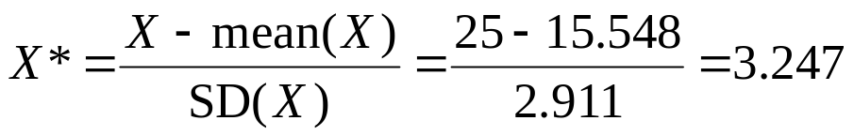
Data Transformation (cont’d)
  Example: Slowest car, “I’ll get there when I’m ready”, takes 25 seconds to reach 60mph
  Using Z-score Standardization:
  Data values that lie above the mean have positive Z-score Standardization values
MD-MIS 637-Fall 2020

Slide 32
Data Transformation (cont’d)
  In summary, Z-score Standardization values typically
  range [ -4, 4 ]
  Field values below field mean → negative Z-score Standardization values
  Field values equal to field mean → Z-score Standardization value = 0
  Field values above field mean → positive Z-score Standardization values
MD-MIS 637-Fall 2020

Slide 33

Data Transformation (cont’d)
MD-MIS 637-Fall 2020

Slide 34
Numerical Methods for Identifying Outliers
Using Z-score Standardization to Identify Outliers
  Outliers are Z-score Standardization values either less than -3, or greater than 3
  Values outside range [ -3, 3 ] require further investigation to determine their validity
  For example, the “I’ll get there when I’m ready” car has Z-score Standardization value = 3.247 (greater than 3)
  Identified as an outlier
  Validity of this value may be determined by discussing results with someone familiar with database content
MD-MIS 637-Fall 2020

Slide 35
Numerical Methods for Identifying Outliers (cont’d)
  Unfortunately, mean and standard deviation used in Z-score Standardization formula are sensitive to outliers
  In other words, mechanism used to detect outliers is unduly affected by presence of outliers
  May be appropriate to choose method for detecting outliers not sensitive to their presence
MD-MIS 637-Fall 2020

Slide 36
Numerical Methods for Identifying Outliers (cont’d)
Using Interquartile Range (IQR) to Identify Outliers
  Robust statistical method and less sensitive to presence of outliers
  Data divided into four quartiles, each containing 25% of data
    First quartile (Q1) 25th percentile
    Second quartile (Q2) 50th percentile (median)
    Third quartile (Q3) 75th percentile
    Fourth quartile (Q4) 100th percentile
  IQR is measure of variability in data
MD-MIS 637-Fall 2020

Slide 37
Numerical Methods for Identifying Outliers (cont’d)
  IQR = Q3 – Q1 and represents spread of middle 50% of the data
  Data value defined as outlier if located:
    1.5 x (IQR) or more below Q1; or
    1.5 x (IQR) or more above Q3
  For example, set of test scores have 25th percentile (Q1) = 70, and 75th percentile (Q3) = 80
  50% of test scores fall between 70 and 80 and Interquartile Range (IQR) = 80 – 70 = 10
  Test scores are identified as outliers if:
    Lower than Q1 – 1.5 x (IQR) = 70 – 1.5(10) = 55; or
    Higher than Q3 + 1.5 x (IQR) = 80 + 1.5(10) = 95
MD-MIS 637-Fall 2020

